Slide 1

PHP Functions || PHP Break & Continue
Umer Shahzad

Slide 2
PHP functions are similar to other programming languages. A function is a piece of code which takes one more input in the form of parameter and does some processing and returns a value.
Umer Shahzad

Slide 3
PHP is a server-side scripting language and a function in PHP is a block of code that performs a specific task and can be called multiple times within a script. Functions can accept inputs (known as parameters) and return a value to the caller. They can also optionally return multiple values using arrays. Functions in PHP are declared using the "function" keyword, followed by the name of the function and a set of parentheses. The code inside the function is enclosed in curly braces.
Umer Shahzad

Slide 4
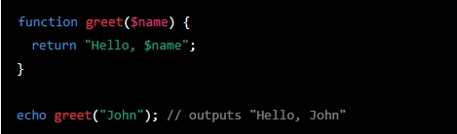
Syntax of Function (Argument):

Slide 5
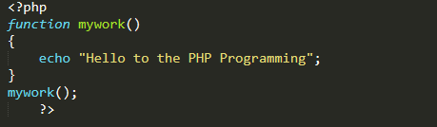
Syntax of Simple Function :

Slide 6
PHP Break Statement:
Break statement:
in PHP is used to terminate the execution of a loop (such as for, foreach, or while) or switch statement. When a break statement is encountered inside a loop or switch, the loop or switch is immediately exited and the code execution continues with the next statement after the loop or switch.

Slide 7
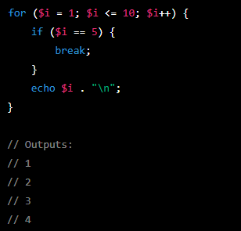
Output:

Slide 8
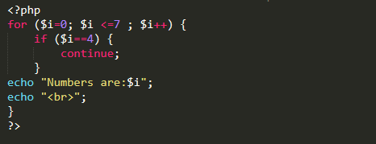
PHP Continue Statement:
.Continue statement:
in PHP is used to skip the current iteration of a loop (such as for, foreach, or while) and continue with the next iteration. It can be used to bypass the code inside a loop that is not relevant to a specific condition.

Slide 9
Thank You! For Giving Your Important Time. “Keep Learning & Keep Exploring”.

